Slide 1

FoodTruckonCampus
Website：https://wfmtzf.axshare.com/#id=b7b0kq&p=home
Jingqi Zhang, Yufei Ye, Ryan Chun Kin Siek, Chengmin Jiang, Shuqi He

Slide 2
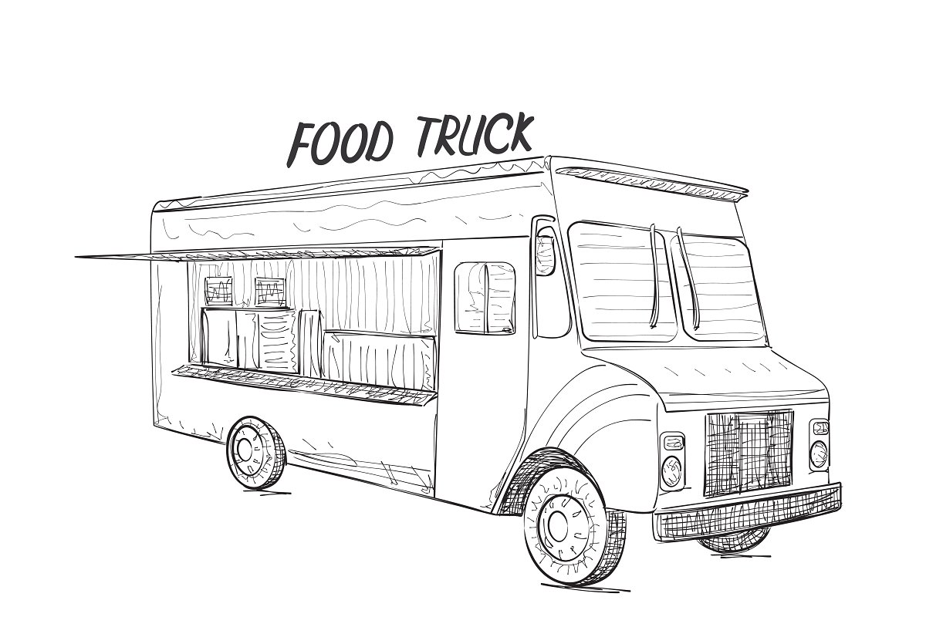
Introduction
Food Truck has become a popular option for university students due to its mobility, cheapness, and convenience.
More students stop by the food truck, which progressively loses its efficiency.
We want to bring back the characteristics of food trucks in order to benefit more students and reach their satisfaction.

Slide 3
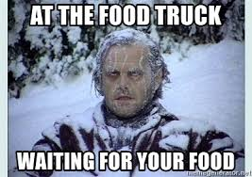
Problem Space
The idea of such problem space initially came from our own life experience.
The waiting time at the food truck is too long!

Slide 4
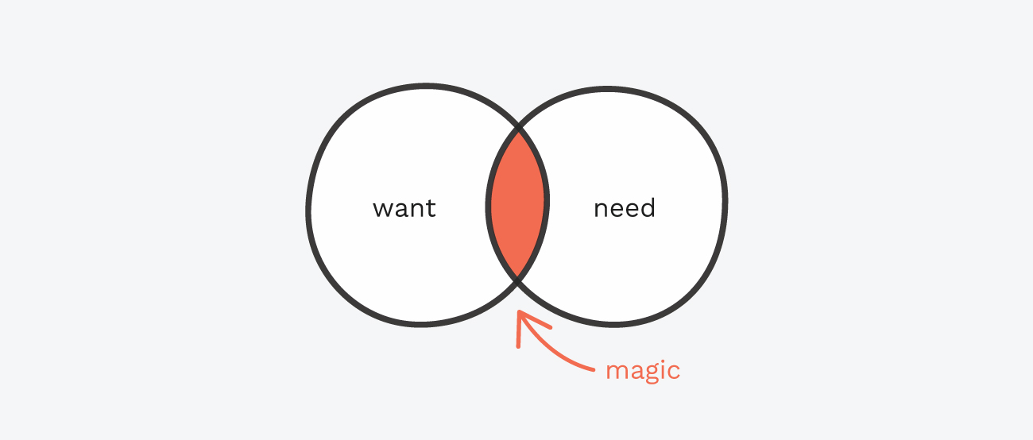
Part 1
User Needs Analysis

Slide 5
Interview Can help to elicit detailed information | Questionnarie Can capture a more representative sample of larger population. | Field Study
27/30 students have bought food from the food truck. 22/27 students complained a lot. | The waiting time is more than 10 minutes: 57.5% The waiting time should less than 10 minutes: 91.3% Food truck only accpet cash: 30.4% | We observed 80 students.

Slide 6

Field Study
Peak Hours | Non-Peak Hours
The average waiting time is 9:16 | The average waiting time is 5:37
But we only have 10 minutes break!

Slide 7
Field Study
Western Food Truck | Eastern Food Truck
The average waiting time is 4:52 | The average waiting time is 10:02
The average waiting time is 7:27

Slide 8

So the problems are...
Food Truck Owners
Students
Too much waiting time that could cause students late for their next course.
Limited payment method.
Language problems.
Too crowed that people cut in line.
Received wrong dishes.
Sometimes they are too busy so they might give students the wrong dish.
It is depressed to see students are leaving because of the waiting line.

Slide 9

Part 2
Design

Slide 10
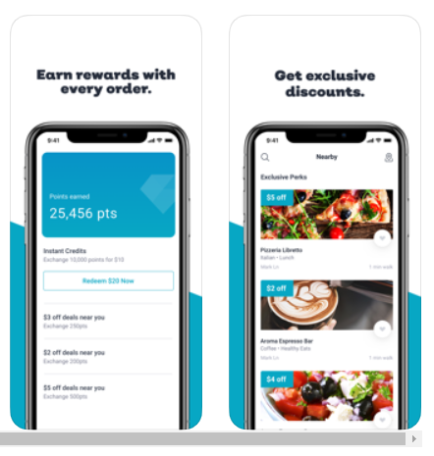
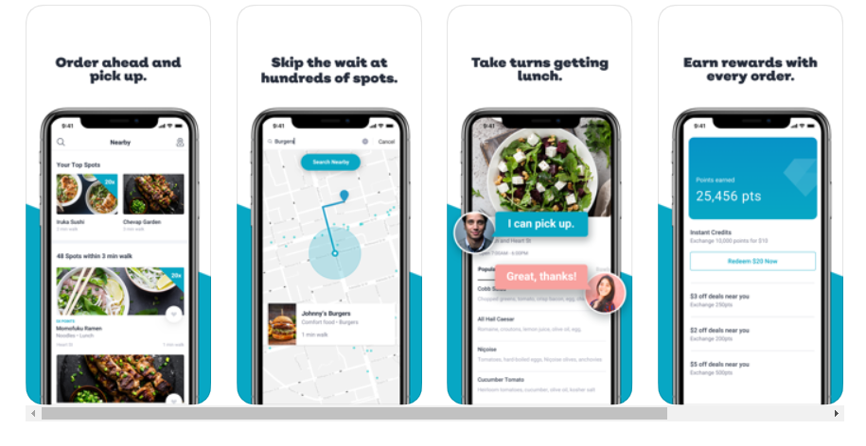
Inspired by RITUAL
Make your order online, and pick up at the restaurant.
Saves the waiting time.
So we designed a website for the food truck on campus.

Slide 11
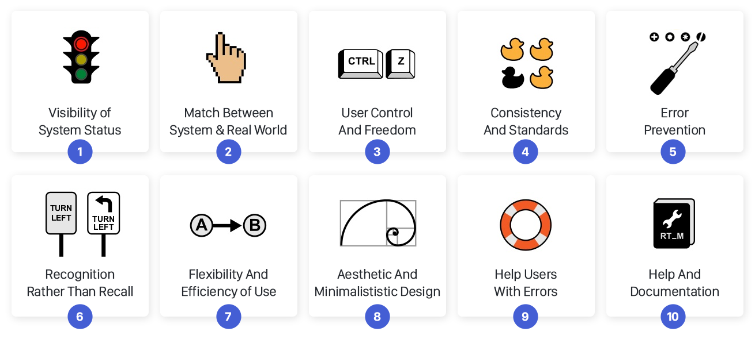
Low-Fi Prototype
We have 5 tasks, which are register system, place or accept orders, and edit the menu.
Participants demonstrate some of the Heuristic Evaluations:
3 - User Control and freedom
4 - Consistency and Standards
7- Flexibility and efficiency of use
8 - Aesthetic and minimalist design

Slide 12

Hi-Fi Prototype
We fixed the low fi prototype base on the feedbacks and create our hi-fi prototype.
We used axure for the Hi-Fi prototype.
We used similar tasks to test our website, and we asked our participatants to speak out what they are thinking during the test.
We fixed the errors base on their feedback.

Slide 13

Part 3
Final Product

Slide 14


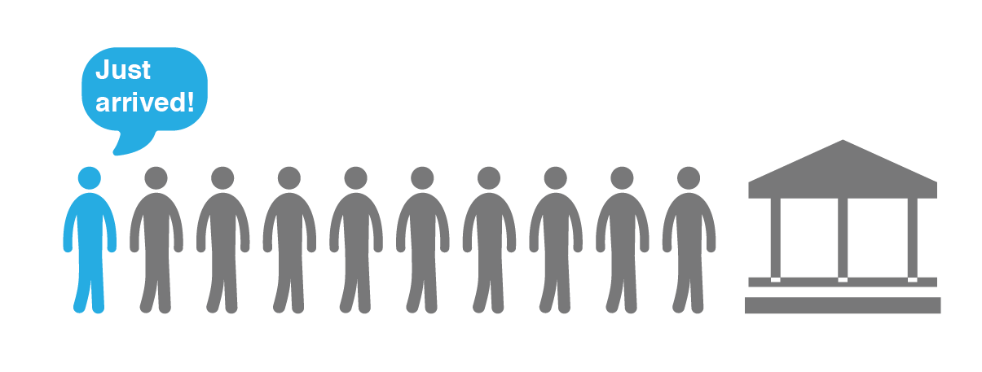
Our final product has...
Searching bar
Estimate waiting time
Current waiting line

Slide 15
Searching engine
The closest food truck, the shortest waiting line.
Customers can choose the food truck base on the situation they are in.

Slide 16
Estimate waiting time
The estimate cooking time for each dish.
Customers can manage their shopping cart with ease.

Slide 17
Current waiting line

Slide 18

Thanks for watching
Jingqi Zhang, Yufei Ye, Ryan Chun Kin Siek, Chengmin Jiang, Shuqi He

